Slide 1

uW Hackathon – 2024
Speech is a primary part of the human/computer interaction requried for drafting/checking stages of Oral Bible Translation (OBT). And some Bible translation efforts target "low resource languages". As such, Bible translation software must understand spoken audio from low resource languages.
Thesis: Find a stable method for recognizing individual words in low-resource languages.
Here, we propose a model to recognize individual spoken words in Dholuo.
Definitions:
Here, "low resource languages" is understood as any language that does not have open, available models for LLM, speech-to-text, and text-to-speech.
By requiring a "stable" model, we require the solution to be independent of tone, volume, speed, or the speaker's gender.

Slide 2
uW Hackathon – 2024
Thesis: Find a stable method for recognizing individual words in low-resource languages.
Here, we propose a model to recognize individual spoken words in Dholuo.

Slide 3
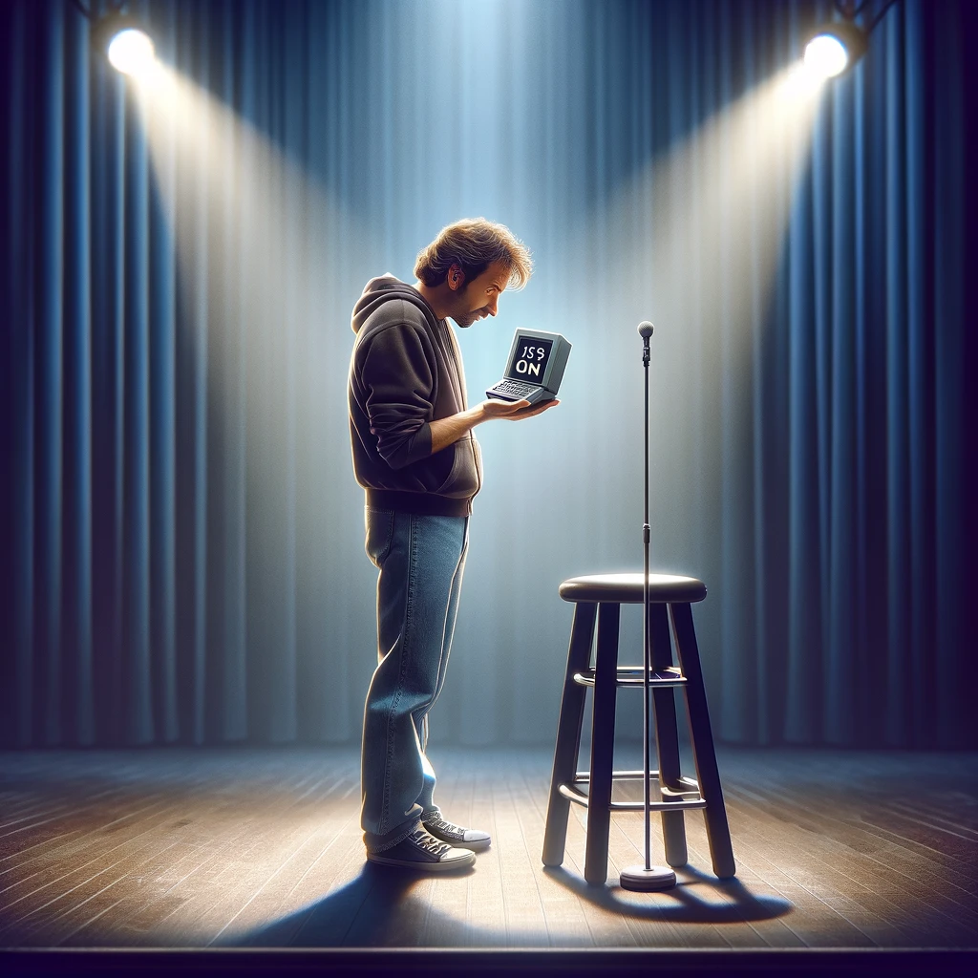
uW Hackathon – 2024
Keyword checking prototype
AKA – “Is this thing on?”

Slide 4
uW Hackathon – 2024
Method:
Python packages:
- librosa Encoding audio data
Collect the Data
Clean the Data
Explore/Visualize the Data

Slide 5
Collect the Data

Slide 6
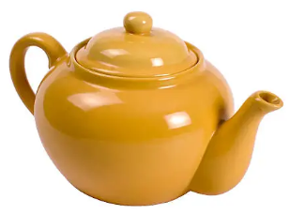

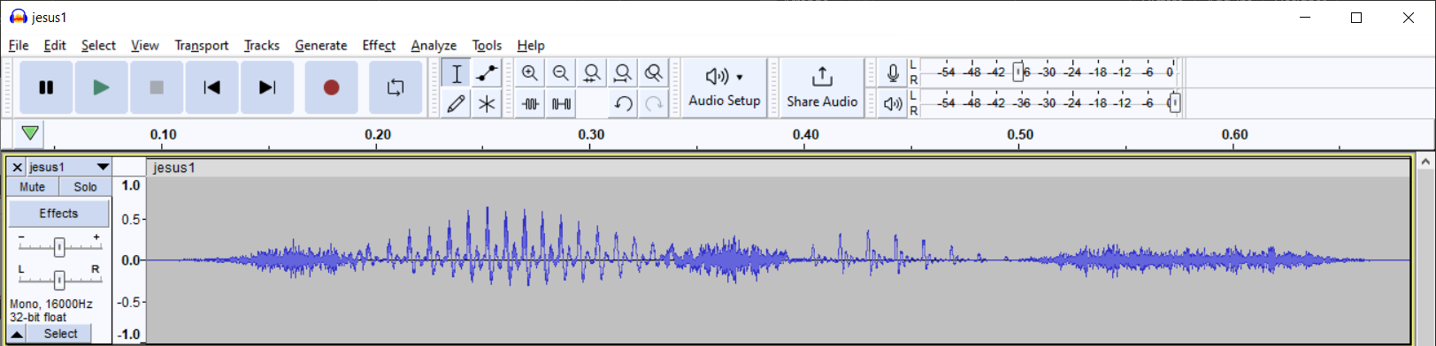
Clean the Data
< 5.3, 3.2, 4, … >

Slide 7
Clean the Data
A standard process for cleaning speech data:
Pre-emphasis:
“Lowering the ceiling”
~ “reducing contrast”

Slide 8
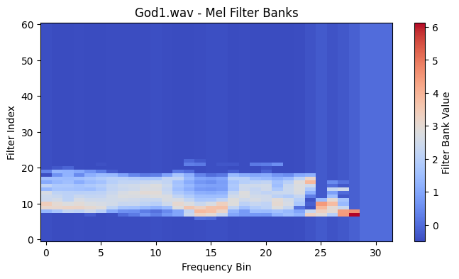
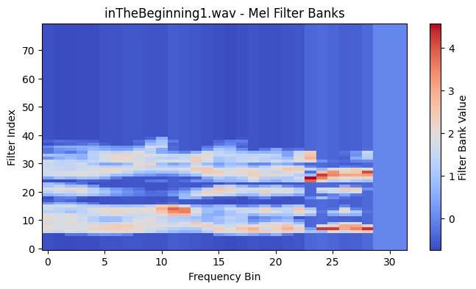
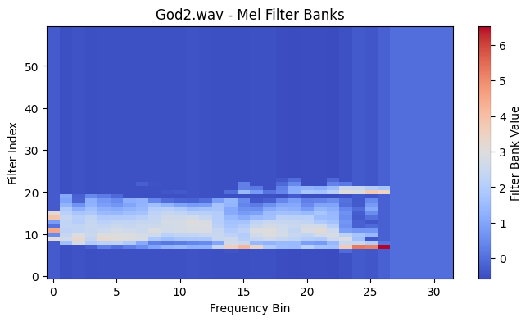
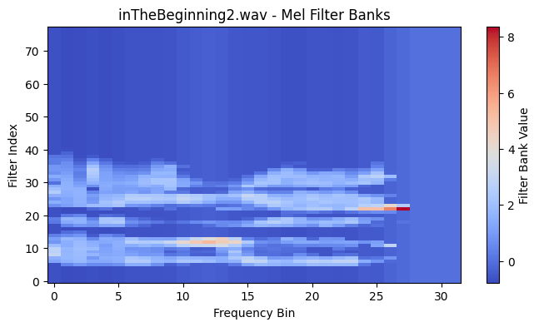
Explore/Visualize the Data

Slide 9
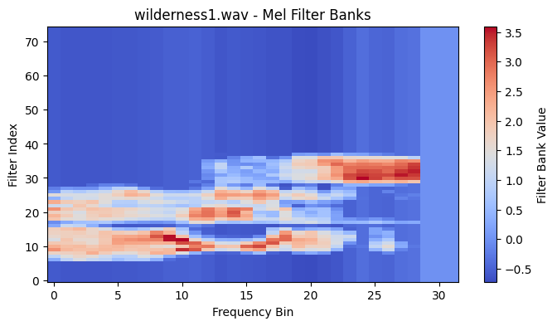
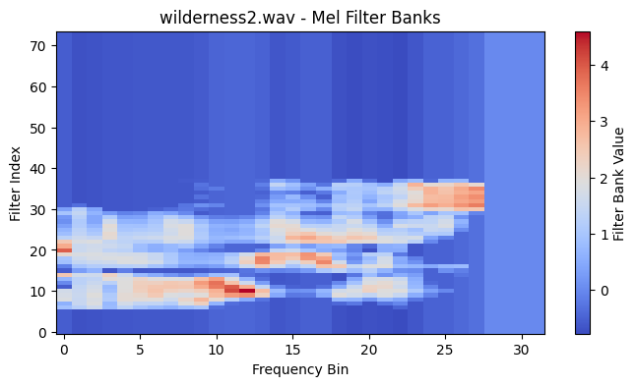
Explore/Visualize the Data

Slide 10
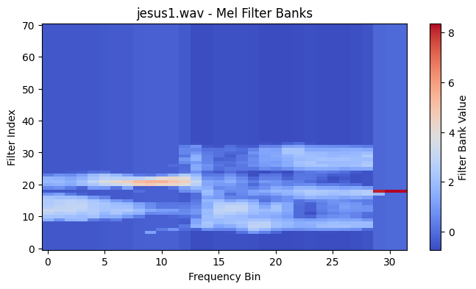
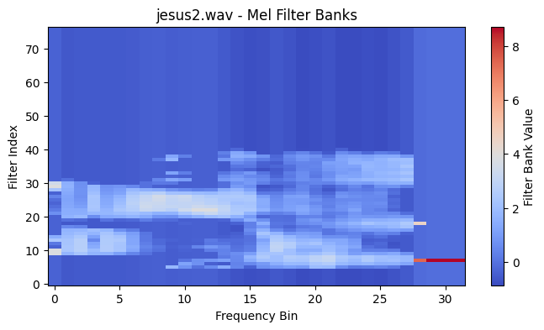
Explore/Visualize the Data

Slide 11
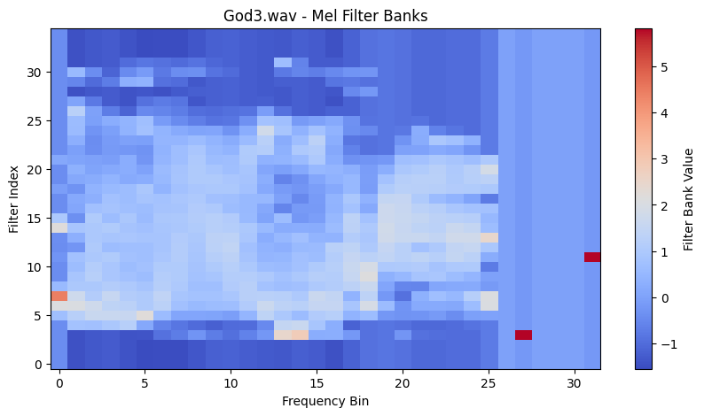
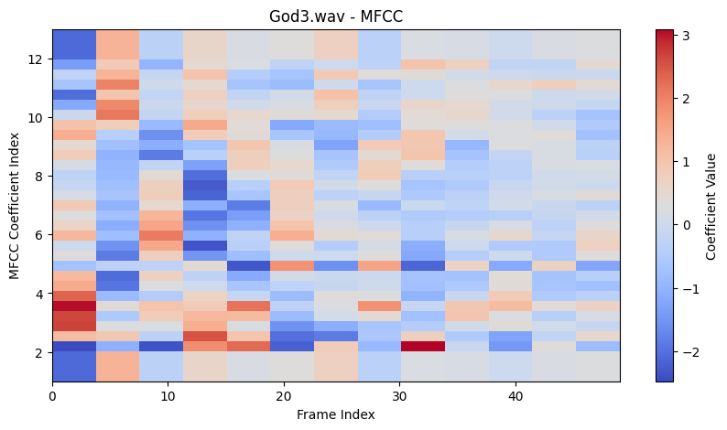

Slide 12
Off-the-Shelf Solution
We can start with an off-the-shelf solution (`librosa` mfcc feature extraction):
✔ This solution correctly identifies the correct forms,
❌ but it does not detect as much difference between the incorrect forms.
For keyword checking, it might be helpful to have a meaningful measure of how different the words are:
No clustering!
Similar to wilderness1.wav:
wilderness1.wav: 0.9999999869496023
wilderness2.wav: 0.9993146675340262
God1.wav: 0.9987559253705995
God2.wav: 0.9980986833151937
inTheBeginning1.wav: 0.9971207291637255
inTheBeginning2.wav: 0.9969806586039947
jesus2.wav: 0.9958133114595762
jesus1.wav: 0.9942425674771389

Slide 13

Report:
Similar to wilderness1.wav:
wilderness1.wav: 1
wilderness2.wav: 0.7229432647124682
jesus2.wav: 0.3134769071964211
God1.wav: 0.23680512842732715
jesus1.wav: 0.21231795463558845
God2.wav: 0.1635381466180469

Slide 14
Application
Keyword checking

Slide 15
Application: Keyword Checking
Check a text
Tagged Data
God
“In the beginning, God..”
Beginning
God
Beginning
Jesus
Wilderness
“In the beginning, was the Word..”
Word
Beginning
Word

Slide 16
(Analytical) Limitations
- Supervised method:
- Requires tagged data
- Poverty of stimulus:
- Needs to collect more data over time

Slide 17
(Practical) Limitations
- Requires Internet access
- Also requires transmitting entire audio file
- ⁉ Possible to port to JS ? → Transmit “Fingerprint”
- File format impedance:
Web audio uses webm/ogg, but analysis libraries use wav/mp3

